Slide 1
Setting up Development Environment
Amir Rashid PIaic107890

Slide 2
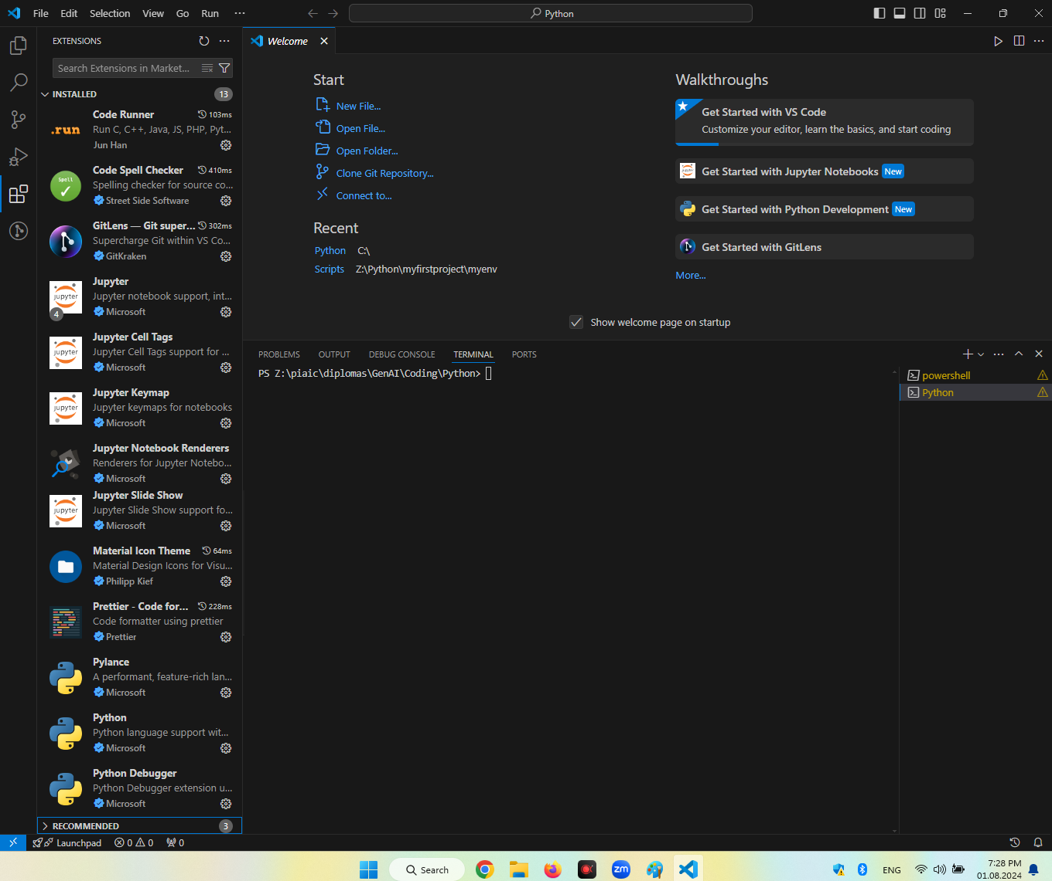

Slide 3
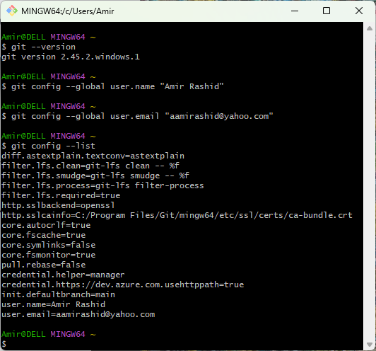

Slide 4
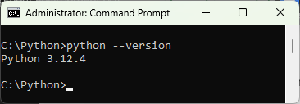

Slide 5
Python Print Function Assignment
Amir Rashid PIaic107890

Slide 6
